Slide 1
Sitefinity Foundations Training

Slide 2
About This Course Trainer: Sahil Pandita Principal Sitefinity Consultant

Slide 3
Description
Students will learn the fundamentals of Sitefinity and acquire the knowledge needed to develop against the platform. It covers a broad range of topics, starting with how to setup the development environment, through how to develop against the presentation layer, and ending with how to work with configurations and administer a website.

Slide 4
Course Goals
By the end of this course, you should be able to:
Setup the development environment
Understand fundamental Sitefinity terminology
Develop against the presentation layer using MVC and Asp.Net Core
Use the platform API to fetch and modify data
Apply basic administration of a Sitefinity website

Slide 5
Audience and prerequisites
The course content is specifically designed to help developers who have little to no experience in developing against Sitefinity to get up to speed.
Before taking this course, it is a plus if trainees:
Have worked with other CMS-es.
Strong experience developing ASP.NET Core applications.
A working knowledge of ASP.NET MVC and .NET Core
Strong experience with HTML and JavaScript.
Experience with CSS
Experience with relational databases.

Slide 6
Presentation Conventions
Useful Tip
Live Demo
Exercise

Slide 7
Agenda
Lesson 1: Introduction to Sitefinity.
Lesson 2: Architecture and Patterns
Lesson 3: Managing Pages and Widgets
Lesson 4: Working with Content
Lesson 5: Rapid Development of Modules
Lesson 6: Rapid Development of Forms
Lesson 7: Customizing Presentation Layer
Lesson 8: Web Services, C# API
Lesson 9: Administration
Notes:
Lesson 1 is short introduction
n to Sitefinity.

Slide 8
Exercise Setup Requirements
Check that your exercise environment is set up correctly:
Do you have the required software installed on your computer?
Windows 10 or Windows Server
Microsoft Visual Studio 2022
.NET Core 6.0
Latest Official Sitefinity 14.2 or higher trial license
Microsoft SQL Server or Microsoft SQL Server Express

Slide 9
Demo Setup you empty Sitefinity project

Slide 10
Lesson 1 Introduction to Sitefinity.
Notes:
Quick introduction lesson.

Slide 11
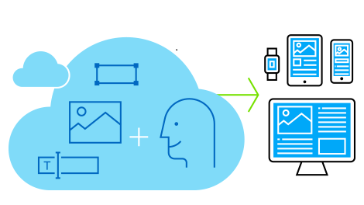
What is a content management system?
A content management system is a software application that enables you to create, store, and manage content such as text, images, and videos.
Content management systems like Sitefinity also provide a platform to publish content, enabling you to create websites, blogs, intranet portals, and eCommerce sites that are accessible over multiple devices.
A content management system enables content creators to add, update, and delete content quickly and efficiently, without having to deal with any of the underlying technologies such as HTML, CSS, or JavaScript

Slide 12
What is Sitefinity?
Fully-featured enterprise ASP.NET MVC based CMS built with ease of use in mind. With the shortest time to market, customers and industry critics acknowledge Sitefinity as the easiest CMS to be managed by non-technical users.
Started as a project by Telerik (Progress Software company) back in 2005, to more than 3.5 million live sites now.
More than 2,000 companies and their clients rely on Sitefinity to engage, convert and retain customers across the entire customer lifecycle.
Winner of Silver Stevie award, Critics Choice Award and Best CMS for Market Award.
Grid Report for Digital Experience Platforms, G2 evaluated Sitefinity as a “leader.” in 2022.
https://www.progress.com/sitefinity-cms
Notes:
Document with useful links will be handled at the end of the presentation

Slide 13
Key features of Sitefinity
Content authoring and management
Multisite and multilingual support
Online forms
Digital marketing features
Mobile-friendly
Performance, scalability, and security
Development tools

Slide 14
Sitefinity Resources
Sitefinity Documentation: The cornerstone of Sitefinity technical information, from content editing to advanced development:
https://www.progress.com/documentation/sitefinity-cms/
Progress Knowledge base: For the rarest cases, not listed in the documentation.
https://knowledgebase.progress.com/
Progress Forums: Large & helpful community
https://community.progress.com
Sitefinity Support Center http://www.sitefinity.com/developer-network/support-center

Slide 15
Sitefinity Vocabulary
Front-end Refers to the live published site that the end user will see. Everyone can see the front-end.
Back-end Refers to the administration portion that is used to create sites in Sitefinity. The back-end is hidden from unauthenticated users.

Slide 16

Exercise: Setup your empty Sitefinity project.
Notes:
Everyone must have a working project, in order to proceed with the training.

Slide 17
Create the Sitefinity .NET Core web application
You install the Renderer in a separate ASP.NET Core application. If you do not have one, create it in the following way:
In Visual Studio, navigate to File » New » Project.
Click ASP.NET Core Web Application » Next.
In Project name, enter Renderer and click Create.
Make sure ASP.NET Core 6.0 is selected and click Create.

Slide 18
Install the NuGet Packages
In your Renderer application, you must install the provided NuGet packages:
Progress.Sitefinity.AspNetCore
Progress.Sitefinity.AspNetCore.Widgets
Progress.Sitefinity.Renderer
Progress.Sitefinity.RestSdk
Progress.Sitefinity.AspNetCore.FormWidgets

Slide 19
Create the ASP.NET Core web application
After you have created the project and installed the NuGet packages, you must configure it to connect it to Sitefinity CMS. In Visual Studio, perform the following
In the Solution Explorer on the right, select appSettings.json.
Add below configurations.
"Sitefinity": {
"Url": “<Sitefinity Site Url>",
"WebServicePath": "api/default"
}
Replace <Sitefinity Site Url> to actual site Url.
Select the program.cs file
Add these code lines to the files
Namspaces
using Progress.Sitefinity.AspNetCore;
using Progress.Sitefinity.AspNetCore.FormWidgets;
Service to the container
builder.Services.AddSitefinity();
app.UseSitefinity();
app.UseEndpoints(endpoints =>
{
endpoints.MapSitefinityEndpoints();
});
To run the application locally you must run the Sitefinity Site First then Run Renderer application

Slide 20
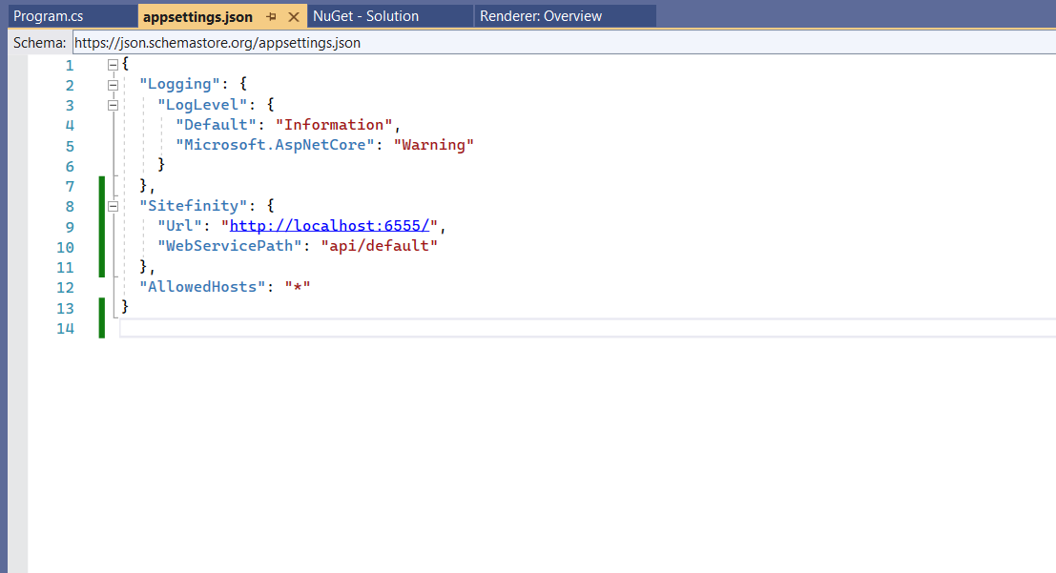
Appsettings.json

Slide 21
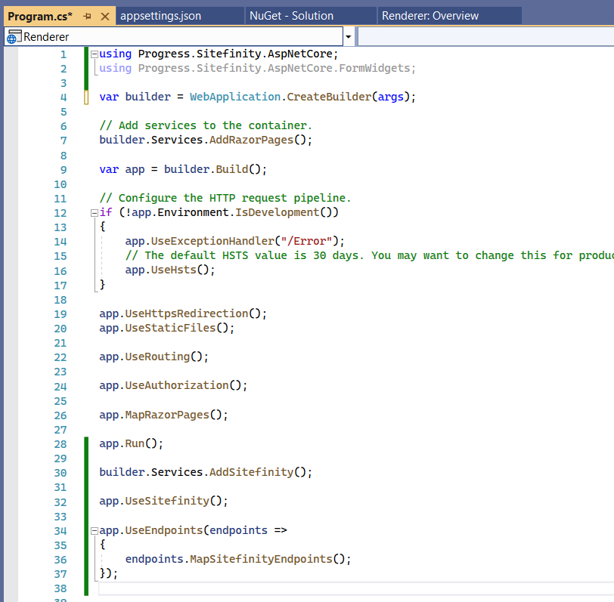
Program.cs

Slide 22
Configure Sitefinity CMS
After creating and configuring your ASP.NET Core application, you must configure your Sitefinity CMS. Perform the following:
In Sitefinity CMS backend, navigate to Administration » Web services.
Open the Default web service.
Under Whom can access the content by this service, select Everyone.
Save your changes

Slide 23
Exercise: Setup your first core renderer.
Notes:
Everyone must have a working project, in order to proceed with the training.

Slide 24
Lesson 2 Architecture and Patterns

Slide 25
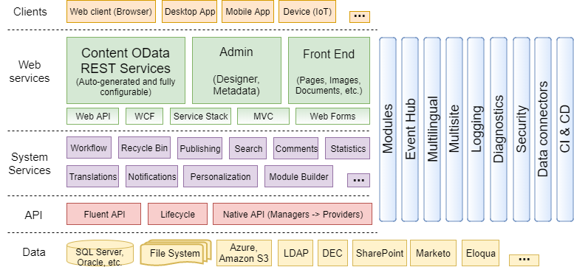
Architecture Overview

Slide 26
News module example – Architecture utilization
Presentation Layer:
Dedicated News widgets with their templates
Service Layer:
A dedicated REST web service
Business logic layer
NewsManager delivers the API of News methods
Data Layer
An abstract NewsDataProvider → A concrete OpenAccessNewsDataProvider
→ Data Access → DB

Slide 27
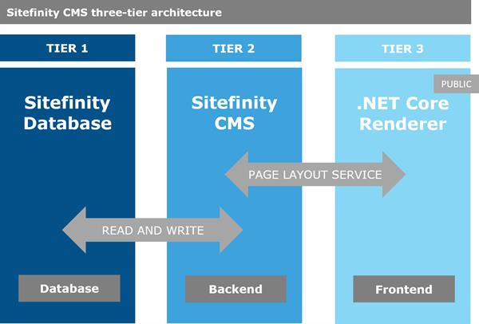
Three-tier architecture

Slide 28
Tier 1 hosts the database
Tier 2 hosts Sitefinity CMS backend administration
Tier 3 hosts Sitefinity ASP.NET Core Renderer that renders the frontend
The .NET Core Renderer and Sitefinity CMS communicate via Sitefinity Page layout service, using REST API calls.
The Renderer handles all .NET Core pages, but also serves as a proxy and forwards all other requests to Sitefinity CMS.
You host the Renderer on your public domain and this becomes the single point of access for all users.

Slide 29
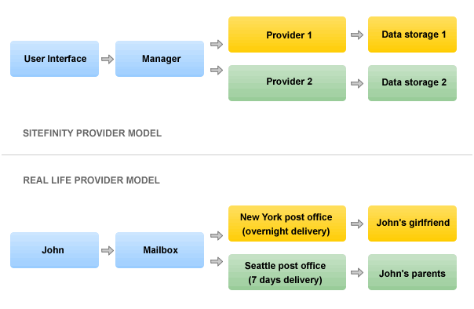
Provider Model
Note: Sitefinity provider model is explained in detail in Sitefinity documentation

Slide 30
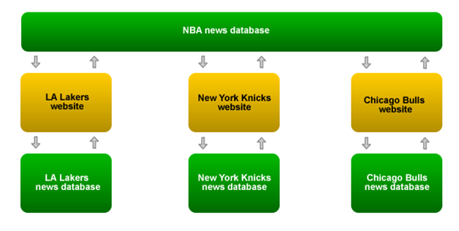
Multiple Providers
Sitefinity CMS supports multiple providers :

Slide 31
Lesson 3 Managing Pages and Widgets

Slide 32
Pages
Pages
Containers of data
Stored in database
Frontend pages vs Backend Pages.
All kind of content displayed in Pages is a responsibility of Widgets
Data that is placed in the containers.
Stored in database
Sitefinity 14.1 has 2 ways to create the pages
Pages with Legacy Page Templates
Pages with Core Page Templates
Core page templates comes with Asp.Net Core Benefits
You will learn more about Widgets later.

Slide 33
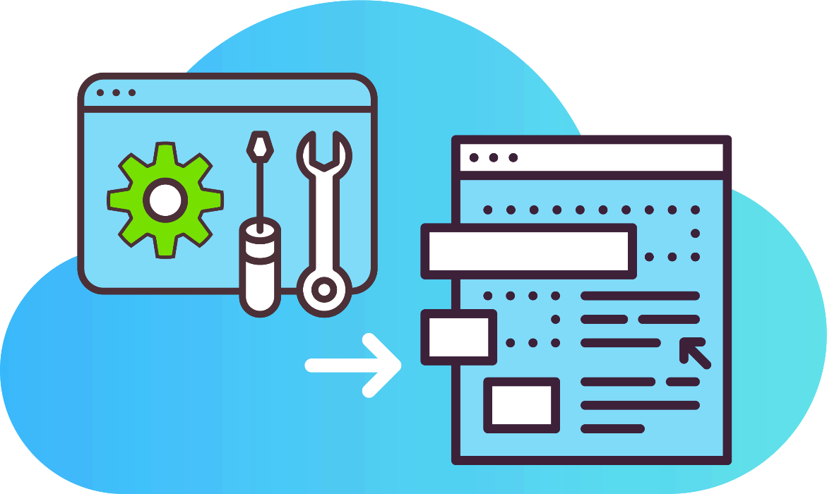
Live Demo
Sitefinity. User Interface. Pages. Tour

Slide 34

Page Templates
Pages inherit Page Templates, displaying all the data dropped in the template placeholders. Templates are useful for optimizing the content editing process.
Stored in the database
Pages are based on Page Templates
Sitefinity 14.1 comes with 2 types of Page templates.
Page Template is based on Resource Package (e.g. Bootstrap)
ASP. Net Core Based Page Templates (Check Bootstrap 5)
Page templates can inherit other page templates, just as pages can, or can be started from scratch.

Slide 35
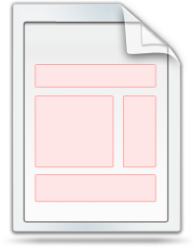



Presentation layer architecture
Template
Page B
Page A
Widget
Navigation Widget
Widget
Empty Placeholder
Widget
Widget
Footer Widget
DB

Slide 36
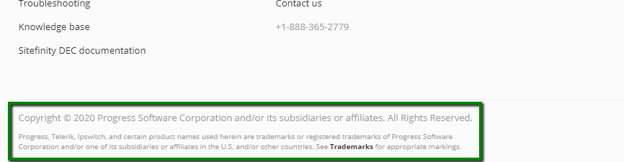
Page Templates
Example of page template usage:
Text in the footer must be changed.
The content editor opens the page template and edits it, instead of opening every page.

Slide 37
Live Demo
Page Templates
https://youtu.be/G7Oy9Lz0VLo

Slide 38
Create a page template and base a page on it (Core)
1. On Renderer application Pages => Shared
2. Copy the one of the Layout and Give your own Name to it.
3. Add “@addTagHelper *, Progress.Sitefinity.AspNetCore” to _ViewImports.cshtml
4. You can provide your own html in layout Files.
5. To create content placeholders you must create tag attribute “data-sf-container” and title of the placeholder.
6. Name of template must include either “Layout” or “Template”.
Notes:
The goal of this exercise is to explain the attendees that the presentation layer consists of pages, page templates and widgets and to show how a simple page with these components can be created.
They can see that page is modularized.
Conclusion: Page creation is component-based

Slide 39
Create a page template (Core)
6. Under Design Click on Page Template.
7. Click on “Create a template” and give a relevant name to it and click Continue.
8. Select New Page Template Create in Renderer application
9. All the core based templates are grouped by “.NET Core templates” and Marked as New Editor
Notes:
The goal of this exercise is to explain the attendees that the presentation layer consists of pages, page templates and widgets and to show how a simple page with these components can be created.
They can see that page is modularized.
Conclusion: Page creation is component-based

Slide 40
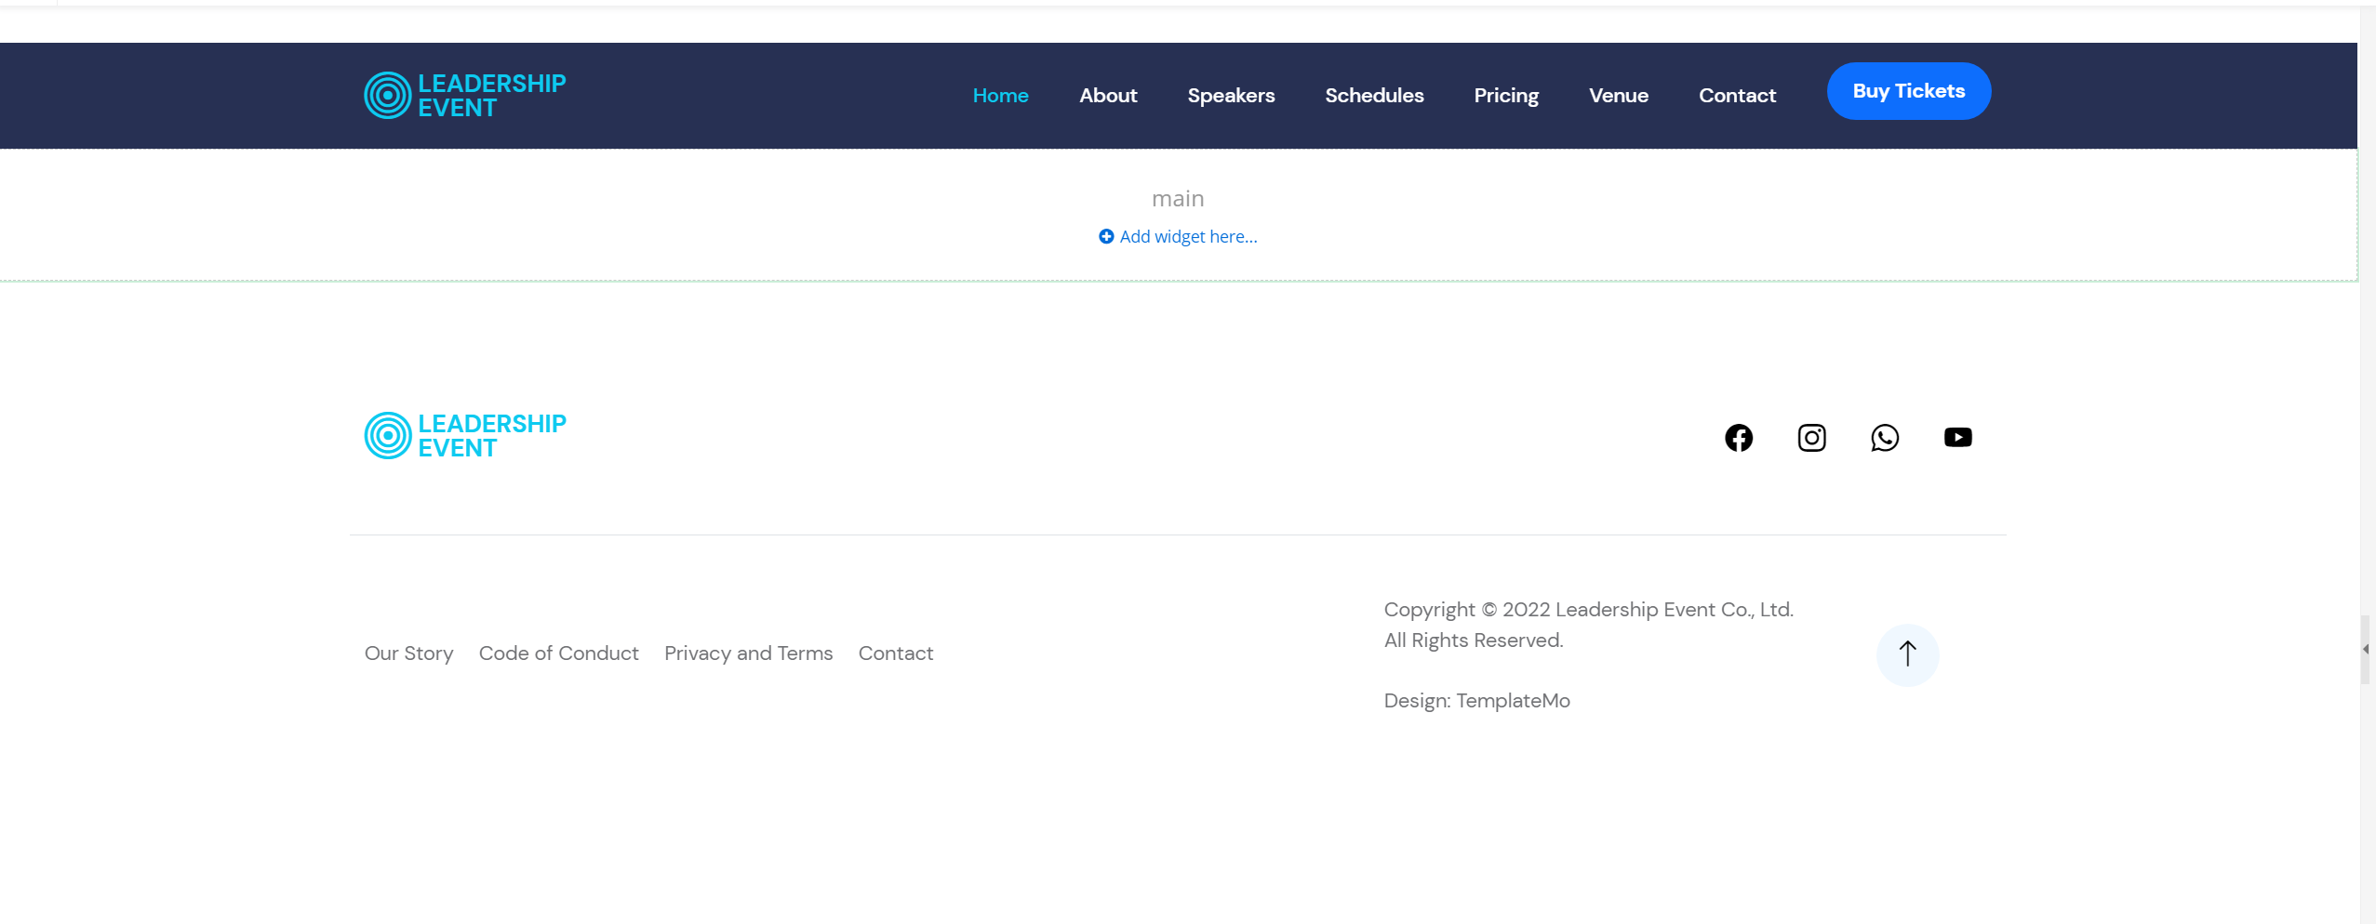
Sitefinity Core Page Template
Anything you want your page to do, you must do it with a widget.
You may click on Add Widget under main section.
Notes:
Provide HTML Link Nuget.

Slide 41
Refining your page or page template by adding sections
A section widget is a container for other widgets.
To add section widget:
Open the page / page template.
Select Layout tab and click on Sections
You can use any of the built-in section widget properties to make to 2 and 3 column.

Slide 42
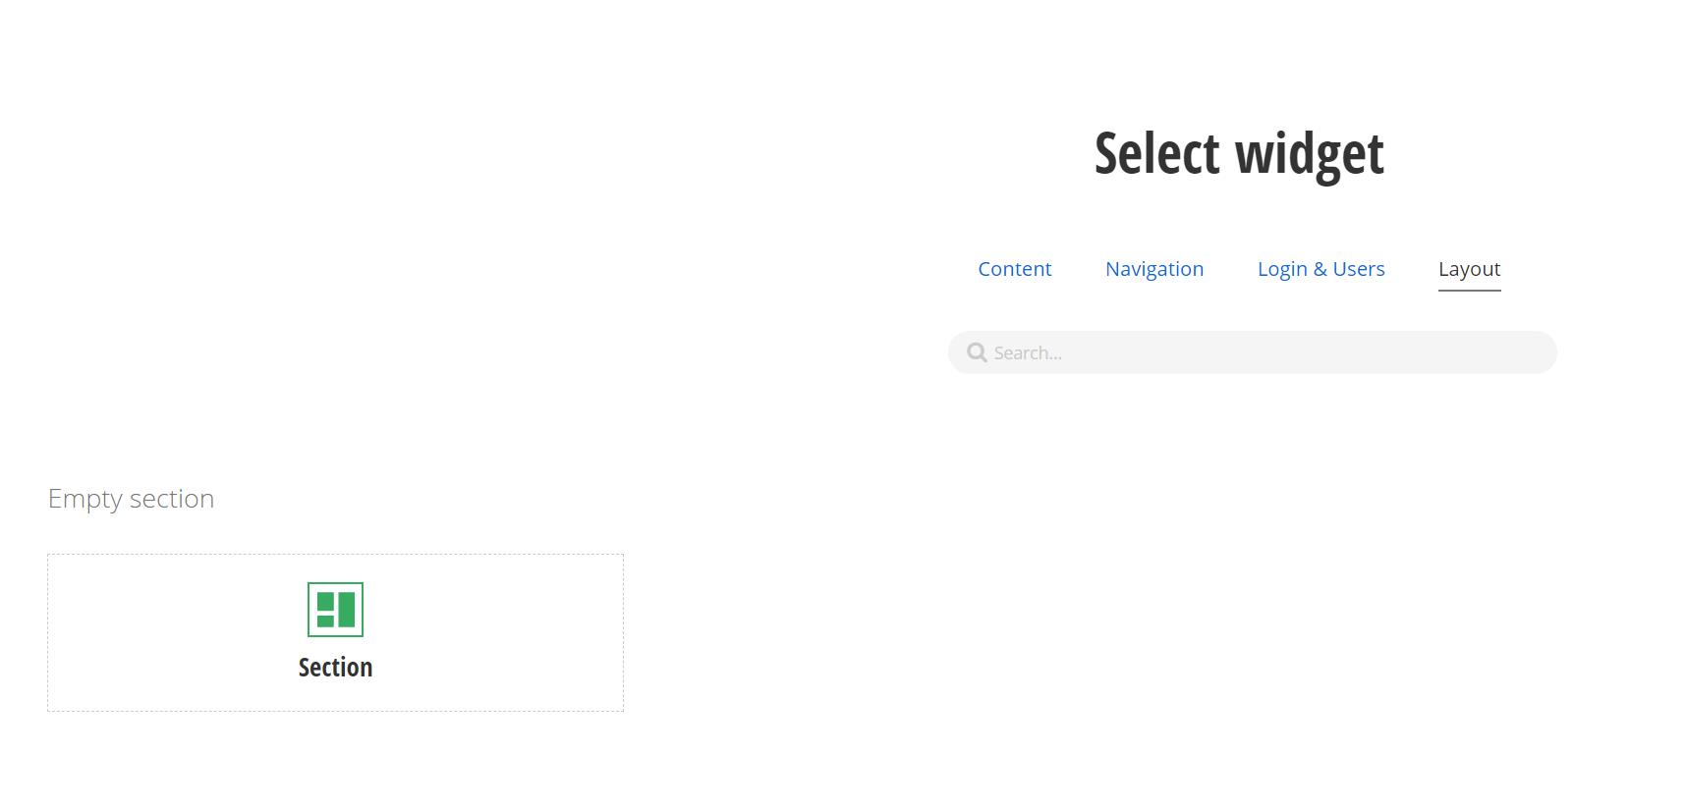
Layout: Section

Slide 43
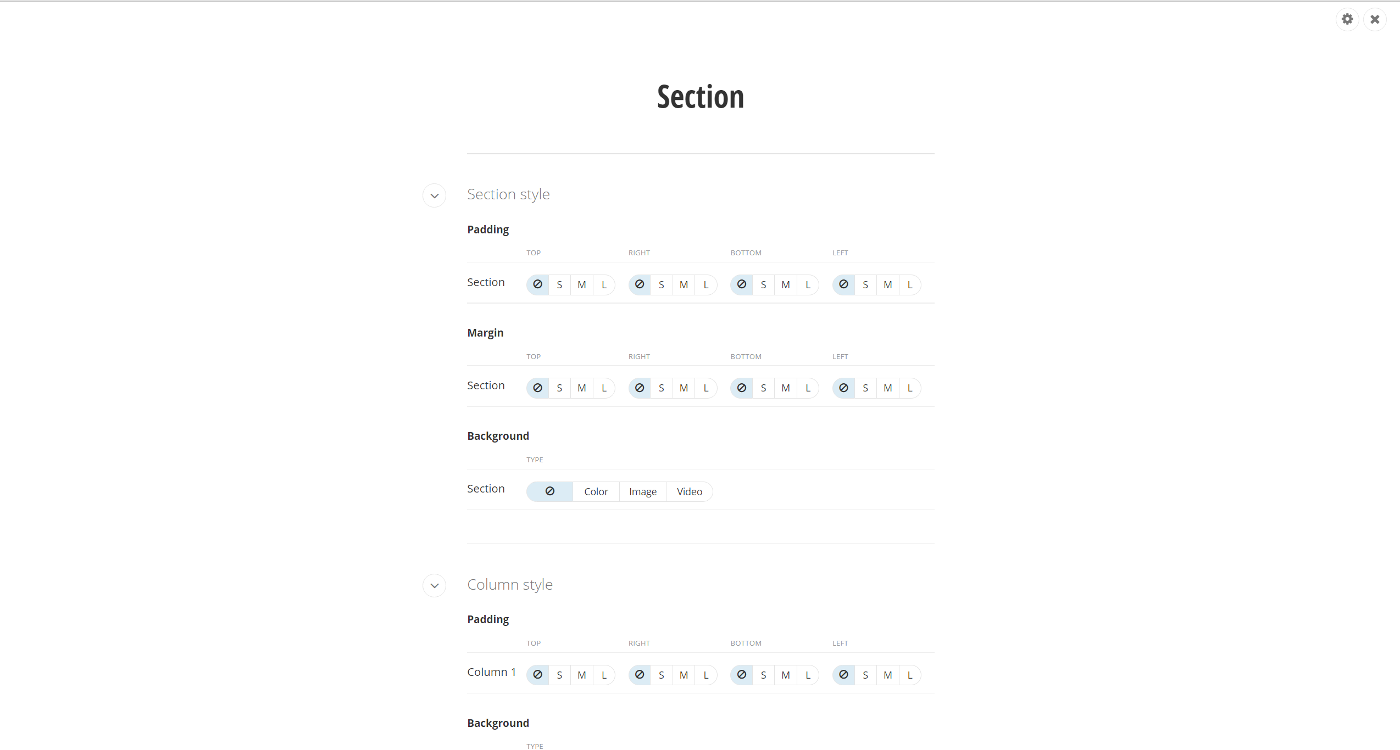

Inline Style Settings
Advance CSS Class and Attribute Settings

Slide 44
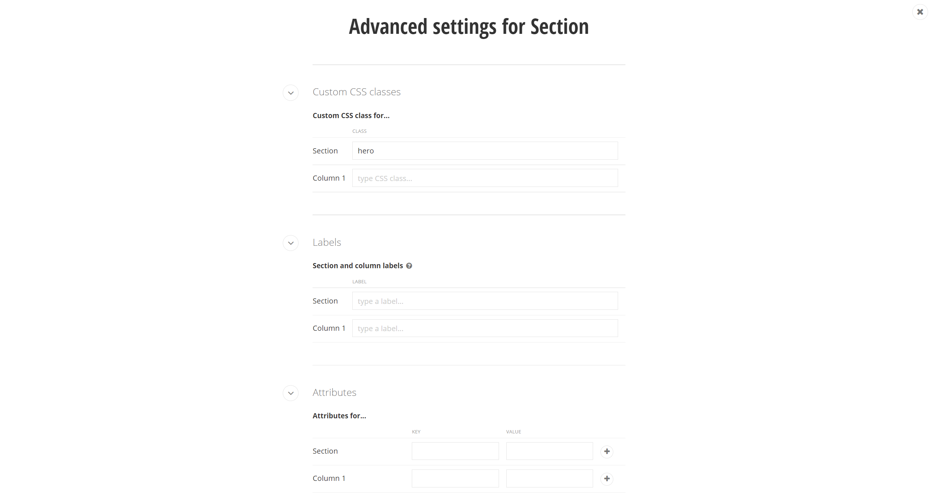
CSS Class
Section Label
Multiple Attributes can be added using “+” Sign
Tag Attributes

Slide 45
Live Demo
Section Widgets

Slide 46
Sitefinity Widgets
Define content and functionality of Sitefinity pages
Sitefinity Core Widgets are divided into following Major Categories
Content
Navigation
Login & Users
Layout

Slide 47
Layout
Section : Used to create Layouts or Placeholders
Content
Content block
Rich Text editor to create content online.
Image
Call to action
New Widget introduced with core. This is used to create redirect buttons
Form
Navigation

Slide 48
Create a page using custom template
1. Run the Renderer application
2. Login to backend of the application
3. Under pages section click create a page
4. Provide Page Title and set other properties and click continue
5. On Template Selection page scroll down and find and select new created page template.
6. Add few sections to position you content
7. Use Content Block Widget , Image, Content List ( to Render Out of the Box Modules like News, Blog etc )
Notes:
The goal of this exercise is to explain the attendees that the presentation layer consists of pages, page templates and widgets and to show how a simple page with these components can be created.
They can see that page is modularized.
Conclusion: Page creation is component-based

Slide 49
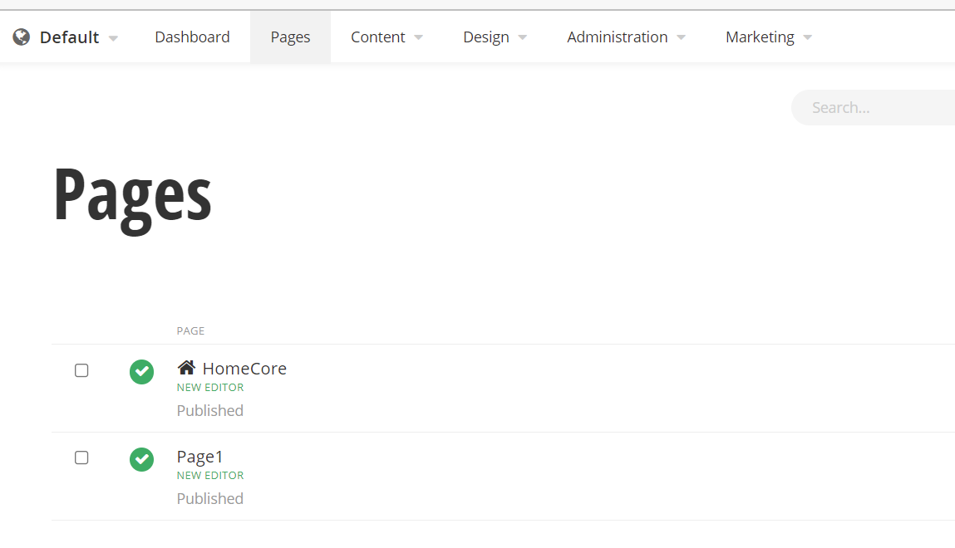
Pages Using Core Templates
Core based pages can be created using core base templates
These are marked as “New Editor”
You must not name the page with any preexisting control on Renderer application.
Notes:
Put a screenshot

Slide 50
Live Demo
Navigation Widget.

Slide 51
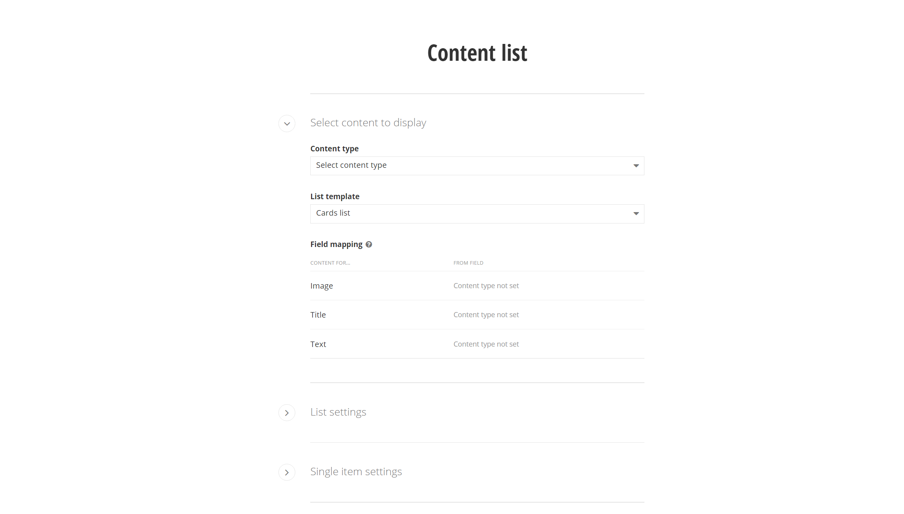
Widget Designers
All the content based widgets are grouped under Content tab.
Widgets like News, Blogs, Events are present in Content list Group.
Here is an example of a News widget designer:
Developers typically need to create widget designers for their custom widgets.

Slide 52
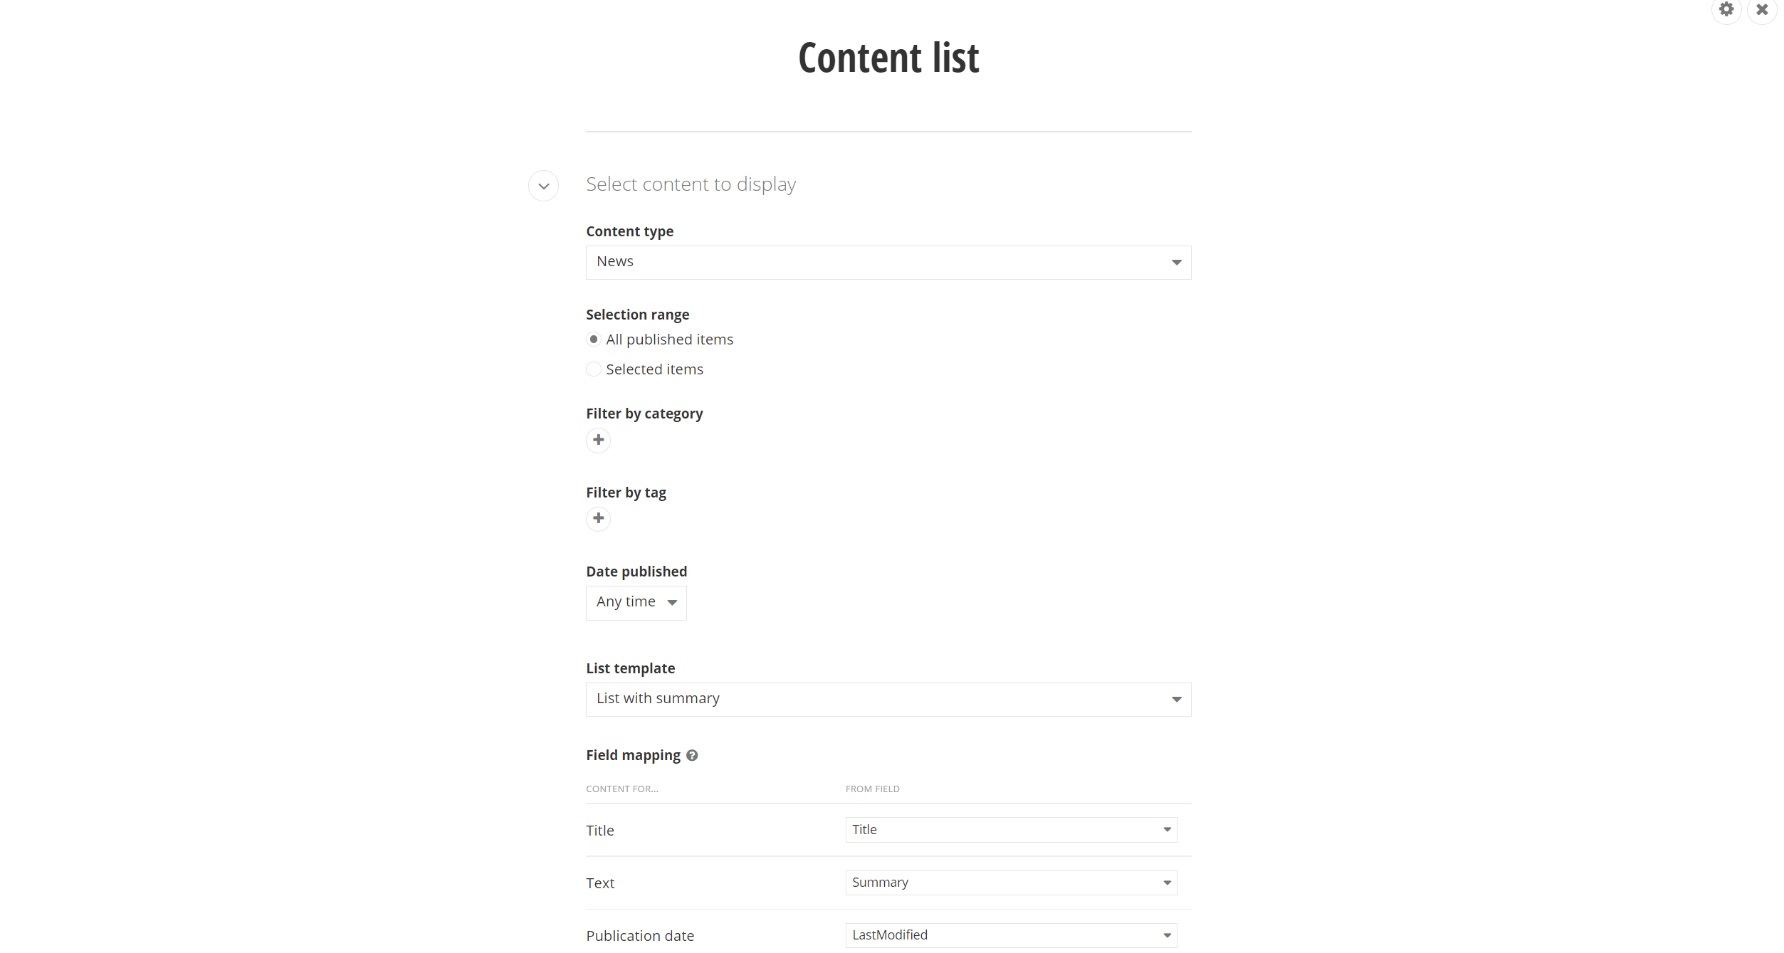
News Widget
Widgets like News, Blogs, Events are present in Content list Group.
Here is an example of a News widget designer:

Slide 53
Live Demo
Content Widgets.

Slide 54
Exercise: Widgets. Content Widgets & Section Widgets
Create the Home Page
1. Create “Home” page. Drop some widgets on them (Images, Content blocks, Image gallery, etc).
2. Using Section widgets create placeholder for content items
3. Configure a website navigation. Create some dummy pages and list them in the navigation.
Tip: Don’t drop the navigation on pages. Drop it on the template you are using: Design > Page Templates.
Notes:
The goal is for the attendee to get comfortable with drag and drop, and the basics of designers.

Slide 55
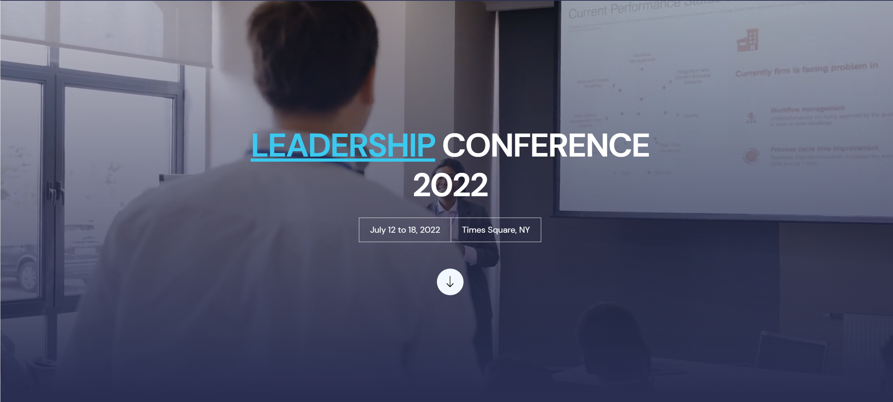
Use Content Block Widget to create Such Banners.

Slide 56
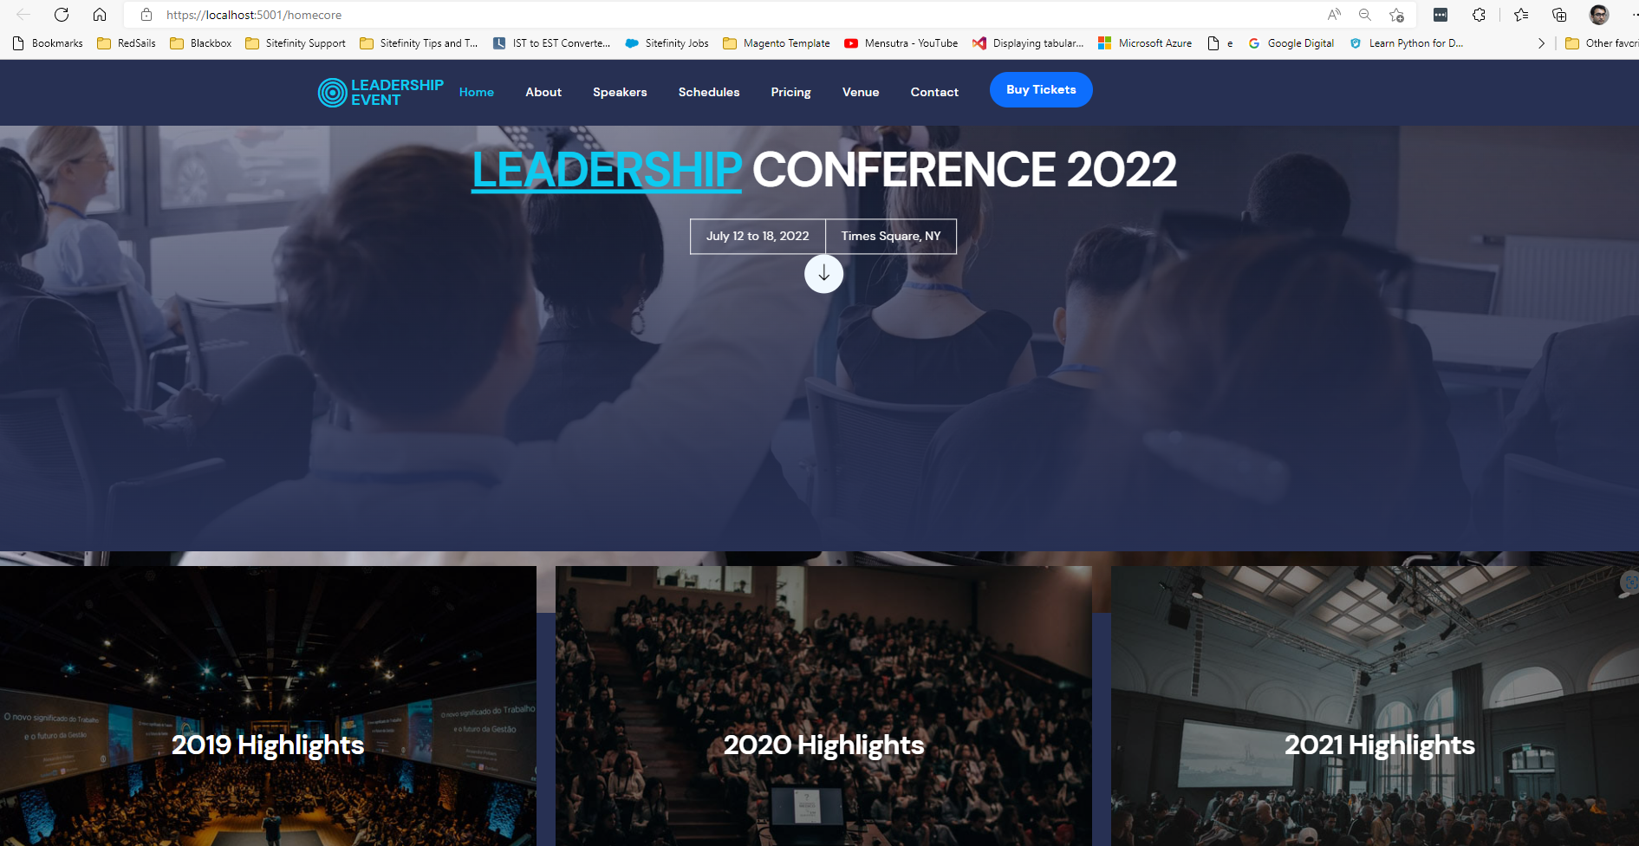

Slide 57
Live Demo
Creation of custom widget

Slide 58
Create a Custom widget using Asp.Net Core
Sitefinity Core widgets, as the name suggest, build in renderer application.
They have a entities;
They have a view;
They have a viewcomponents;
Developers familiar with ASP.NET Core, would know how to work with an Custom widget in Sitefinity Core.
Sitefinity official documentation has well written step-by-step guide and examples of custom widgets, including code snippets.

Slide 59
Exercise: Create a “Hello World” Sitefinity Core widget
In Renderer application add new Folder names “ViewComponents”. Add a Class Named “HelloWorldViewComponent”.
HelloWorldViewComponent Class should inherit from ViewComponent Base Class. CS Class should have attribute “[SitefinityWidget]”.
Create a folder named “Entities” a Model Class named “HelloWorldEntity”. add a string type property
Then Create Another folder named “Views/Shared/Components/HelloWorld”. Add a code file and name it “Default.cshtml”
Build and test.
Notes:
Create a Static Content Widget Example with few properties ( Static News Widget) Add Git Link for this Component

Slide 60
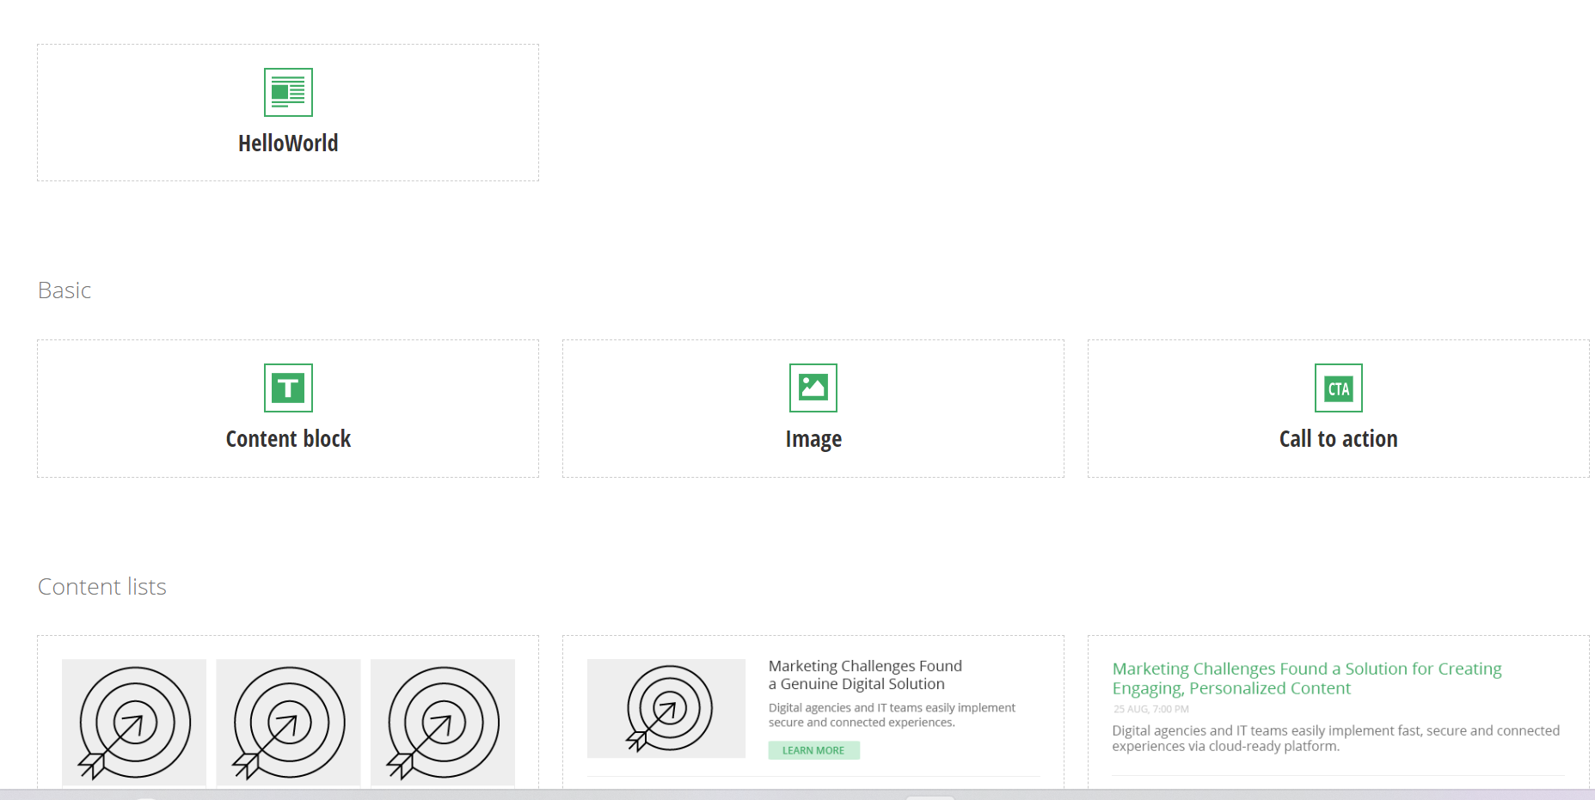
New widget will appear on under content tab on page edit.
Select and edit HelloWorld widget to set any message for the widget

Slide 61
Exercise: Create a “Custom News” Sitefinity Core widget
In Renderer application add new Folder names “ViewComponents”. Add a Class Named “CustomNewsViewComponent”.
CustomNewsViewComponent Class should inherit from ViewComponent Base Class. CS Class should have attribute “[SitefinityWidget]”.
Create a folder named “Entities” a Model Class named “CustomNewsEntity”. add few string type properties like Title, Body,links etc
Then Create Another folder named “Views/Shared/Components/CustomNews”. Add a code file and name it “Default.cshtml”
Build and test.
Notes:
Create a Static Content Widget Example with few properties ( Static News Widget) Add Git Link for this Component

Slide 62
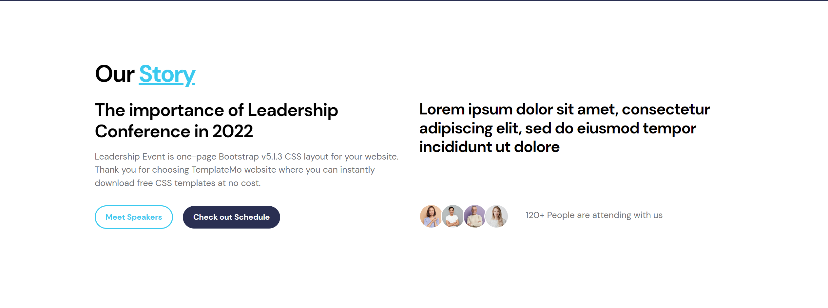
This can be created by using custom Widget

Slide 63
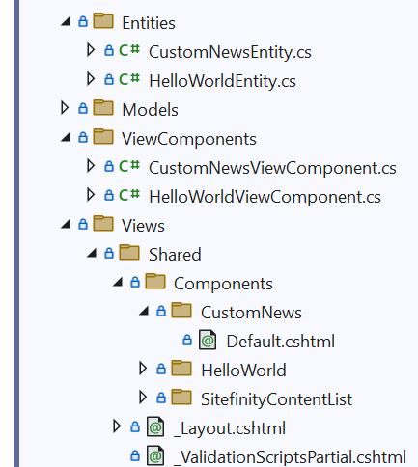
Create a cs file under ViewComponents Foder with Name having Suffex ViewComponent in the name of the file.
Create a Model under entities folder.
Create a View under “Views/Shared/Components/CustomNews” Folder.
CustomNewViewComponent will inharit from ViewComponent base class.
ViewComponent can be use to fill the model and pass the collection to view.

Slide 64
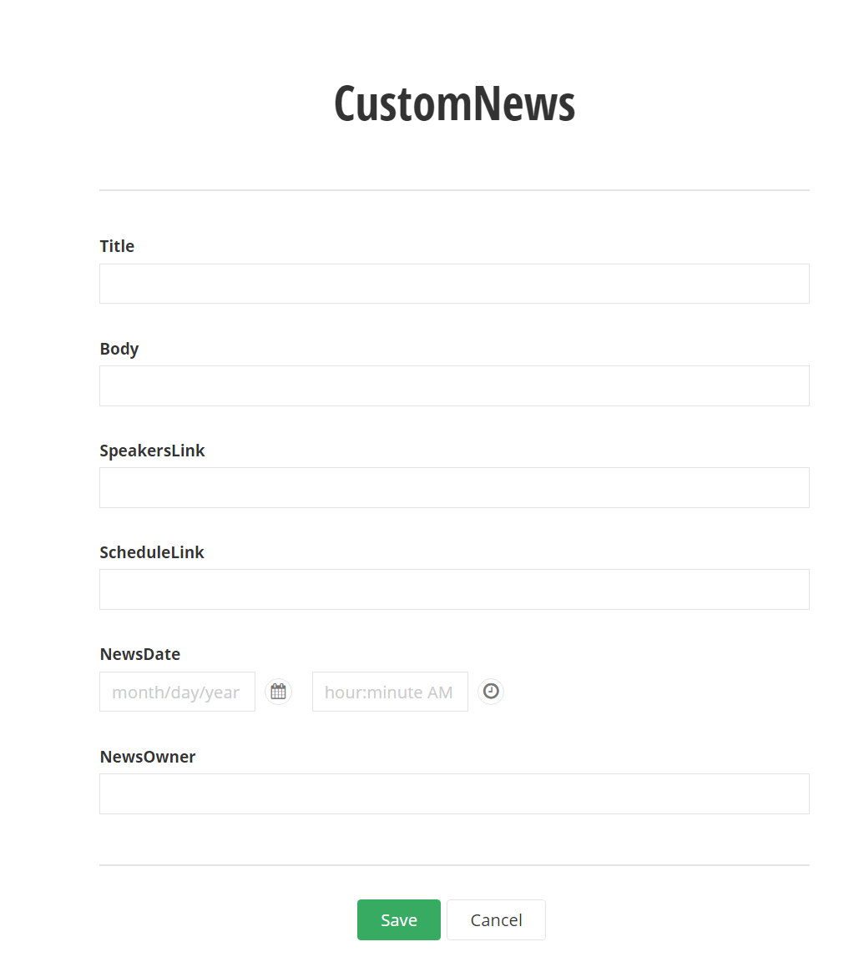
Create a cs file under ViewComponents Foder with Name having Suffex ViewComponent in the name of the file.

Slide 65
Lesson 4 Working with Content

Slide 66
Content List Modules
You create content using the Sitefinity CMS content list modules.
Content List Modules store reusable content
Might be used in many website pages.
Might be consumed by other integrations, or just kept in the back-end for administrators.
Other users can view, edit, and publish it as well.
Important:
Content modules not to be mistaken by Service Modules (Also called Intra-modules or Periphery modules)

Slide 67
Content List Modules
Content List Modules hierarchy
News as an example of one level structure
Blogs as an example of hierarchical content structure.
Images, Videos, Documents & Files – as an example of content, stored in Libraries
Libraries storage – Database, File System, custom.
List and Details Templates are used to display Content. We can customize these templates to display content as per design.
Proper content creation & editing in modules is very important for SEO. Alternative text for images, proper URLs, meta information is handled there.

Slide 68
Live Demo
Built-in modules. Modules CRUD.
Notes:
Dont talk for PUBLISH , Unpublsih & etc here. Only go for Create edit delete.

Slide 69
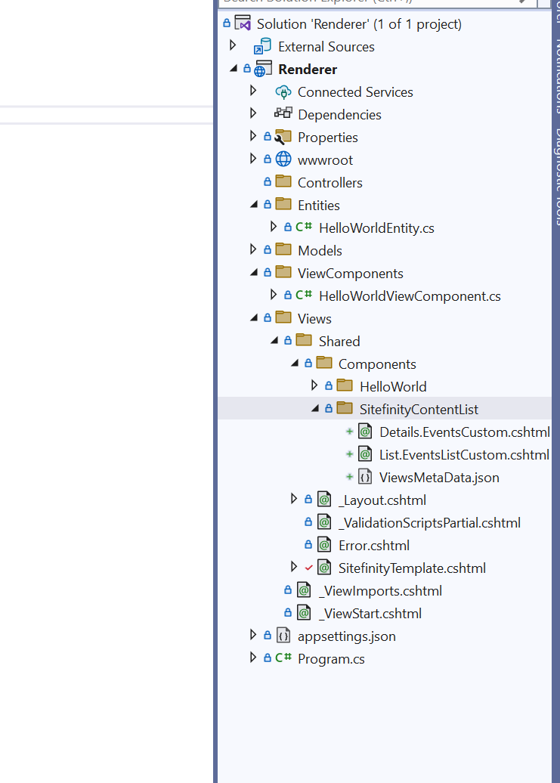
Custom List Module Template
Create folder with component name for which we are going to create the custom widget
Create 2 cshtml files list.<templatename>.cshtml and details.<templatename>.cshtml
One json file name as ViewsMetaData.cshtml
ViewMetaData Defines the Fields Mapping to content fields.

Slide 70
Types of Workflow statuses 1/2
Published
content is visible on the front-end
Draft
initial state of an item when first created
Draft (newer than Published)
When published version is edited without being published again
Notes:
LATER

Slide 71
Types of Workflow statuses 2/2
Scheduled
assigned date and time when it will be automatically published or unpublished.
Unpublished
not visible on front-end
Locked for editing
item cannot be opened, because it is being edited by another user.

Slide 72
Live Demo
Content Workflow.
Schedule for publishing.

Slide 73
Customizing Build-In Content Modules
Available field types
Text (Short text / Long text field)
Choices (Checkboxes / Radio buttons)
Boolean (Yes/No)
Date & Time
Number
Classification
Related Media
Related Data (Next Slide)
If you must add too many custom fields, consider using a dynamic module instead.

Slide 74
Related Data
Allows relation of other Build-In or Custom Modules
Simple fields only example
Related Data example
Blog Post
Title | Short Text
Content | Long Text (rich text editor)
Author Name | Short Text
Author Avatar | Related Media (Image)
Author Twitter | Short Text
Blog Post
Title | Short Text
Content | Long Text (rich text editor)
Author | Related Data (Author Module)
‘Author’ module carries Name, Avatar and Short text. Author avatar can be changed once, and change will apply everywhere this author is displayed.

Slide 75
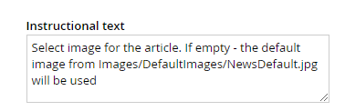
Customizing Build-In Content Modules 2/2
Custom fields - backend users experience
Backend labels & texts
Predefined values
Limitations
Have content editors off all expertise levels in mind when creating custom fields. Do proper explanations, give examples in labels & predefined values.

Slide 76
Live Demo
Custom Fields for Build-In content modules.

Slide 77
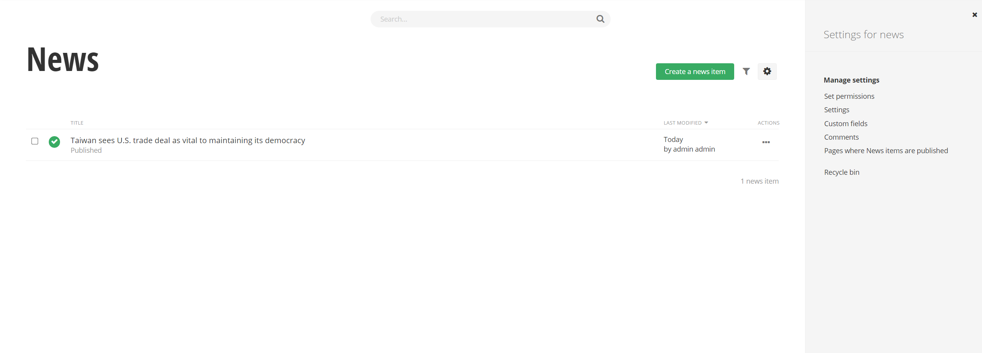
Used to Open Settings Window on Right
Used to open Custom Fields List

Slide 78
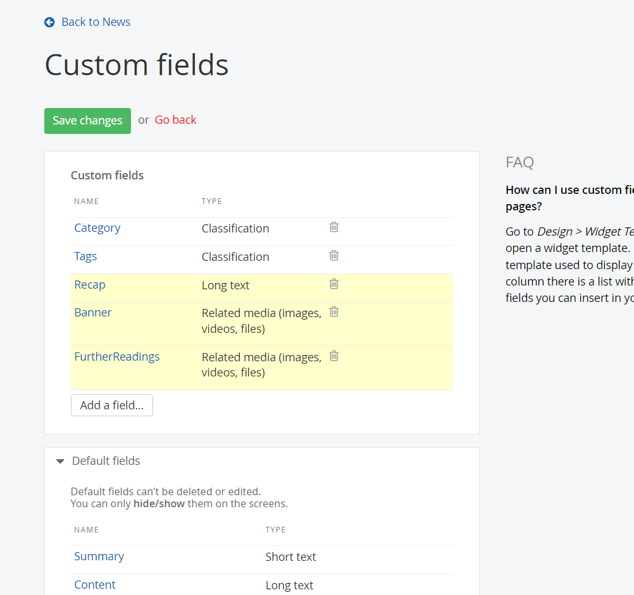
List of Custom Fields added

Slide 79
Exercise: Extend the News module.
Add ‘Recap’ long text field.
Add ‘Banner’ image.
Add ‘Further Readings’ related documents.
Notes:
Add only 1 image for banner and Multiple files for related documents.
Explain how 1 or multiple images might break views.

Slide 80
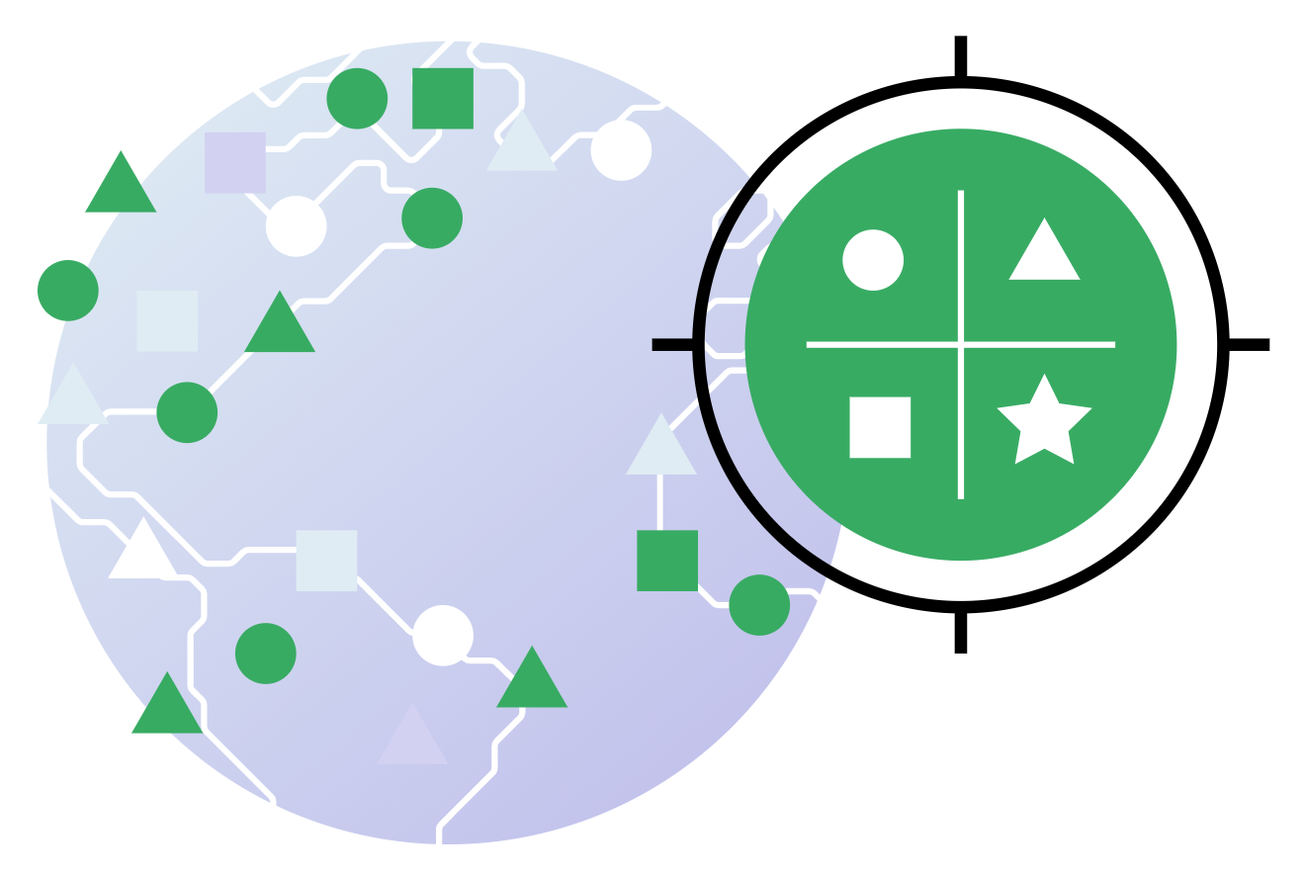
Taxonomies
Use classifications to organize content items, such as news, events, images and all kind of custom or build-in modules.

Slide 81
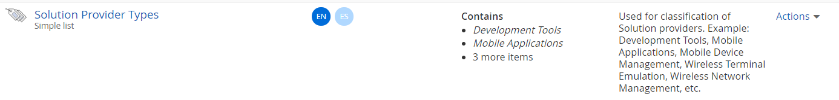
Taxonomies
Build-In
Tags – build-in flat taxonomy
Category – build-in hierarchical taxonomy
Custom taxonomy

Slide 82
Taxonomies
Flat taxonomy
Finance
Economics
Politics
Entertainment
Healthcare
Technology
Hierarchical Taxonomy
Business
Banking
Tech
Transport
Entertainment
Hollywood
Sport
Soccer
Hockey

Slide 83
Taxonomies Vocabulary
Taxonomy – the whole classification
‘Tags’ is a build-in flat taxonomy.
‘Categories’ is a build-in flat taxonomy.
‘Organization Type’ is a custom flat taxonomy. (Public, Private, Government, NGO)
Taxon – single Taxonomy item.
For example: ‘NGO’
Taxa – many Taxon
For example: Thriller, Horror, Drama
Notes:
Can this be explained better?

Slide 84
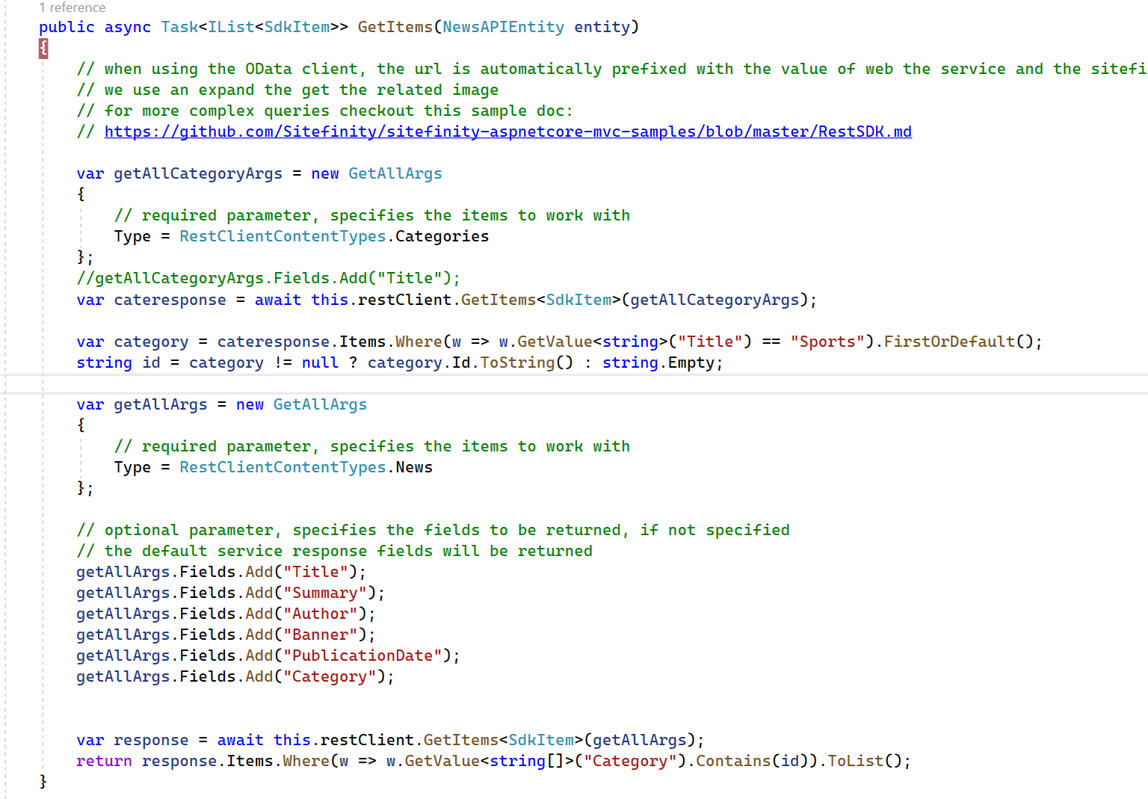
Custom New Widget (Rest API)
Notes:
Can this be explained better?

Slide 85
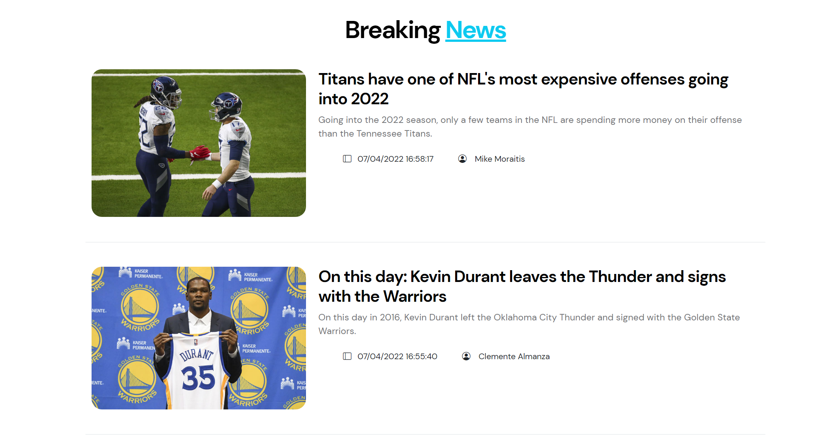
Custom Image Field Banner
Title
Summary
Notes:
Can this be explained better?

Slide 86
Exercise: Build-In Taxonomies.
Create a few sample news items and categorize them by Business, Politics and Sport.
Configure a news widget to display ‘Sport’ articles only.
What kind of taxonomy are you going to use?
Why?

Slide 87
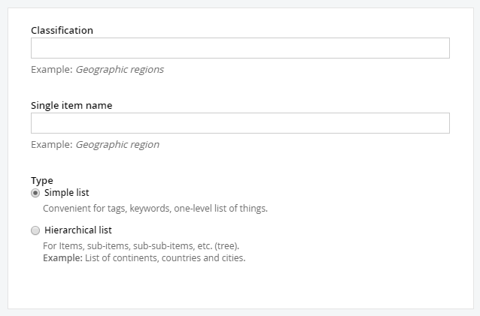
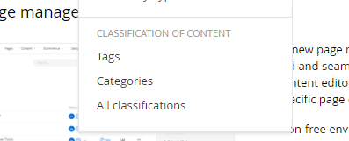
Custom Taxonomies
Create your own flat or hierarchical taxonomy
Notes:
Can this be explained better?

Slide 88
Live Demo
All taxonomies preview.
Creating a custom Taxonomy from the backend.
Notes:
Backend > content > All Classifications page (the very bottom)

Slide 89
Lesson 5 Rapid Development of Modules

Slide 90
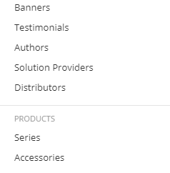
Dynamic Modules
Dynamic Module – to fit your business needs, when build-in modules aren’t enough.
Example dynamic modules:
Authors – Name (short text), Avatar (Related Media), Twitter URL (short text)
Testimonials – Client (related data), Text (long text), Rating (Number 1-5 incl.)

Slide 91
Dynamic Modules Fields
Available field types – Just as the custom fields for Build-In modules
Text (Short text / Long text field)
Choices (Checkboxes / Radio buttons)
Boolean (Yes/No)
Date & Time
Number
Classification
Related Media – Images, Files, etc.
Related Data (Next Slide)

Slide 92
Dynamic Modules Related data
Related data example
‘Testimonial’ Module
Title | Short Text
Content | Long Text (rich text editor)
Client | Related Data (Client)
Rating | Number (0-5)
‘Client’ Module
First Name | Short Text
Last Name | Short Text
Company | Related Data (Company module)
Occupation | Short Text
Avatar | Related Image (Single)

Slide 93
Live Demo
Dynamic Modules & Module Builder

Slide 94
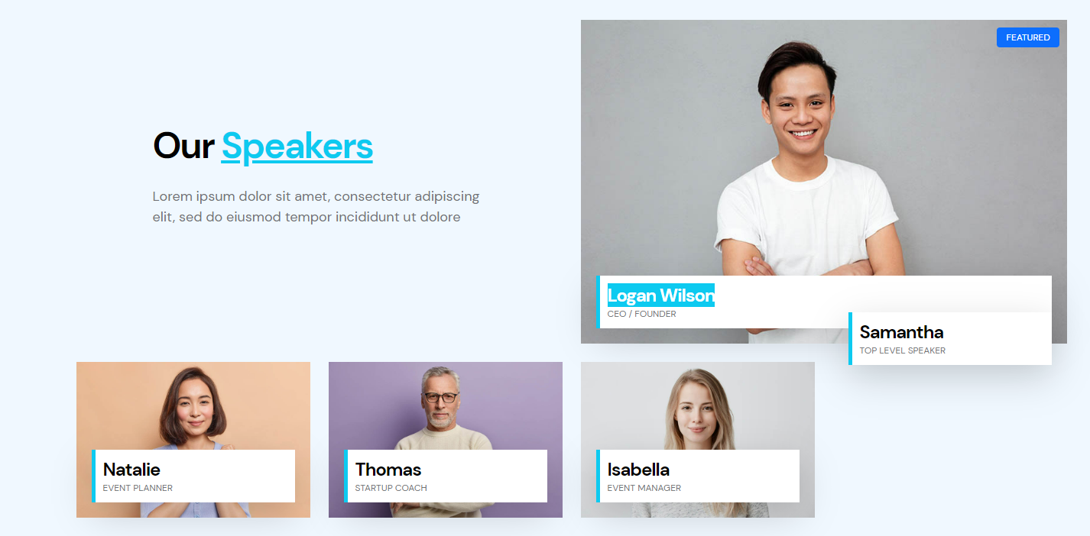
Exercise: Create Our Speakers Module
Notes:
Which fields would be required, to display such content?
Note: On click – content is opened with more text.
Note – board of directors' tab vs executive management tab? Why not using taxonomies for this?

Slide 95
Dynamic module widgets.
The fastest way to display data stored in modules is to take advantage of Dynamic module widgets.
Auto Generated once a module is created
Allows List and Detail views, like stock content widgets (News, Events)
Allows taking advantage of powerful widget designer (filtration of items by tag, date, etc.)
Allows creating custom templates or modify existing ones to fit your presentation needs.

Slide 96
Live Demo
Dynamic Module widgets.
Notes:
After this add Core Widget Templates

Slide 97
Lesson 6 Rapid Development of Forms.

Slide 98
Forms Module image for forms
Module to allow storing of user-generated content
Accessed in Content > Forms > Form responses
Building a form – similar experience as page editing, via form widgets.
Form displayed on pages via the Forms widget

Slide 99
Forms Introduction
Forms
Forms – a built-in module Used to complete a survey, fill in questionnaires, thus collecting information in an easy and streamlined manner.
Forms Builder
Takes advantage of the same WYSIWYG:
drag and drop editor - similar experience as page editing, via form widgets.

Slide 100
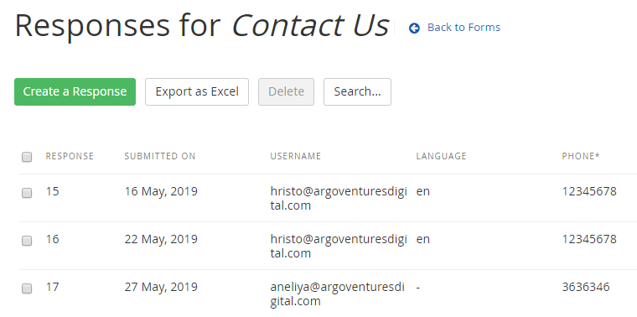
Form responses
All forms responses are stored in Sitefinity
CRUD operations available.
No workflow (Published, Unpublished, etc.)
Exportable as Excel
Notes:
PDF is also an option. Check my blog post: https://www.sitefinitytipsandtricks.net/2015/03/12/form-entry-pdf-export/

Slide 101
Live Demo
Forms & form responses. Forms Builder. Advanced: SMTP Settings

Slide 102
Lesson 8 Web Services, C# API and platform Events

Slide 103





OData Web Services
Sitefinity Services Module
Expose all modules and CRUD operations.
Allows developers to use modern front-end frameworks.

Slide 104
OData Web Services
OData Web Service module allows:
CRUD
Paging
Sorting
Filtering
Related Data
Security
Authentication
Logging
Permissions

Slide 105
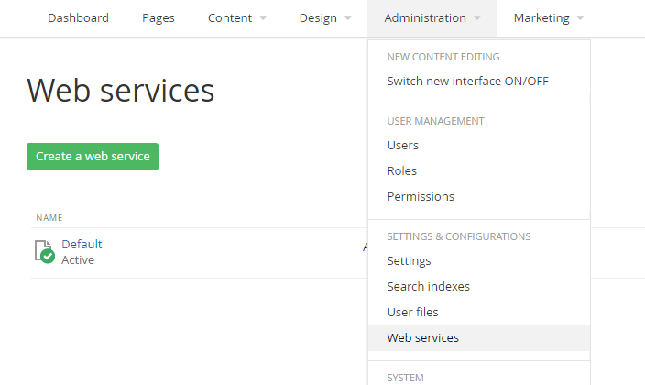
OData Web Services
Default Web Service
All content Included
Create your own Web Service
Choose specific content
If you don’t see ‘Web Services’ under Administration tab, you should enable the Web Services intra-module from Administration > Modules & Services

Slide 106
Live Demo
Web Services Walkthrough.
Notes:
Backend > content > All Classifications page (the very bottom)

Slide 107
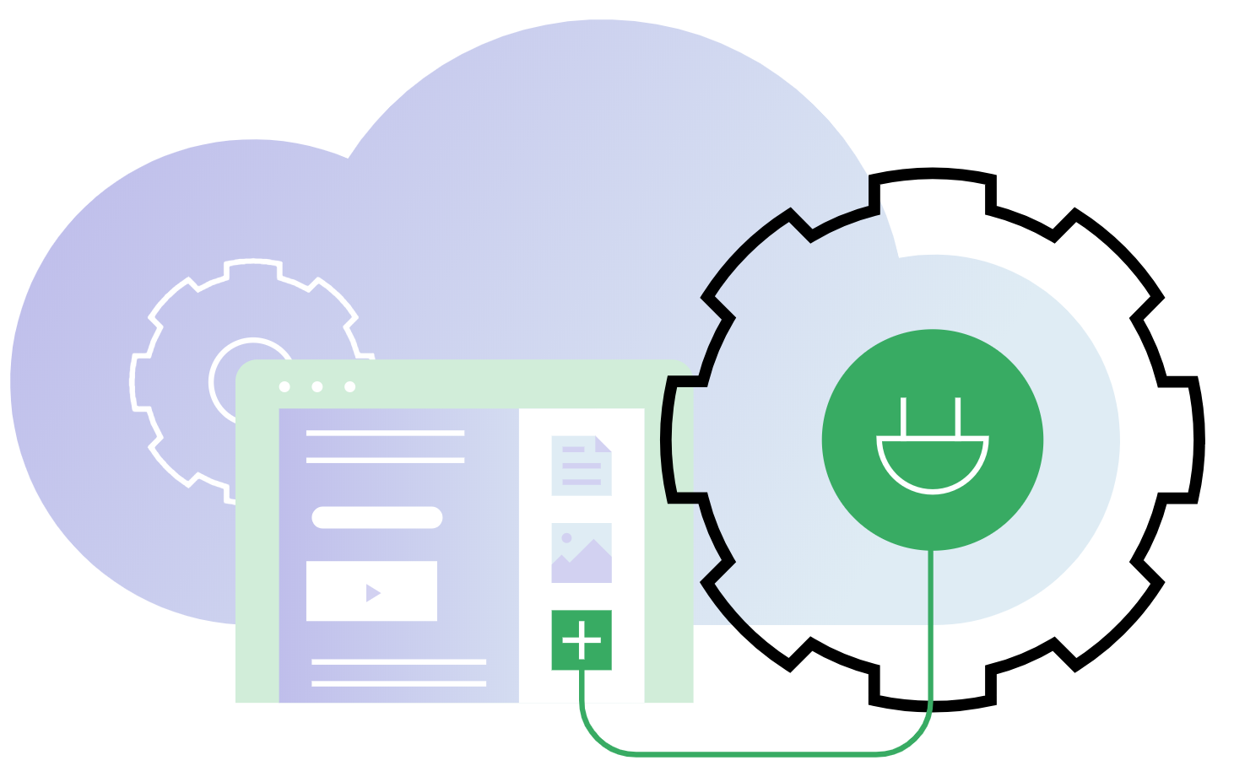
Sitefinity API
.NET API exposing data from Sitefinity Database, File System, External Systems, In-memory cache, etc.

Slide 108
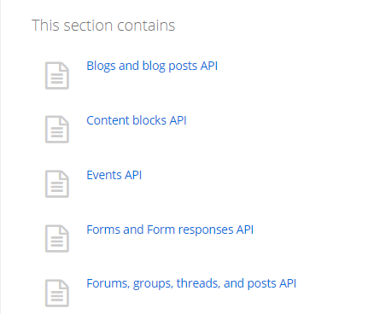
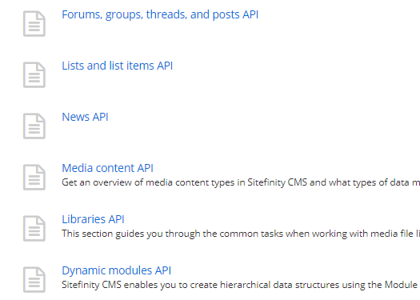
Sitefinity API
Native vs Fluent API
We will not be covering Fluent API in this course
Sitefinity API covers lots of Build-In and Dynamic content, Users, Roles Configurations, and many more…
Notes:
Create Custom widget using News API

Slide 109
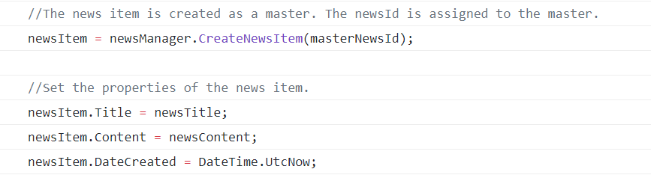
Sitefinity API
Most common usage case:
CRUD Operations with content items.
CRUD Operations with content items are very well documented in the Sitefinity API documentation. Always compare your code to it when working with the Sitefinity API.

Slide 110
Live Demo
Native API.
Query News Item.
Notes:
Backend > content > All Classifications page (the very bottom)

Slide 111
Taxonomies API
Use the Sitefinity API to modify taxonomies and assign or unassign content items to/from given taxonomy

Slide 112
Taxonomies API
Taxonomies API allows:
CRUD operations.
Associate content item with taxon
Remove association of content item with taxon.
Flat Taxonomies API and Hierarchical Taxonomies API have major differences. Always compare your code with the Sitefinity Taxonomies API documentation
Notes:
Create a Custom Widget in Core

Slide 113
Live Demo
Taxonomies API.
Notes:
Backend > content > All Classifications page (the very bottom)

Slide 114
Exercise: Display all ‘Tags’ Taxa in your ‘Hello World’ custom widget, comma separated. Hint: Google ‘Taxonomies API Sitefinity Documentation’
Advanced: Display all Taxa from a custom Taxonomy.
Notes:
Add only 1 image for banner and Multiple files for related documents.
Explain how 1 or multiple images might break views.

Slide 115
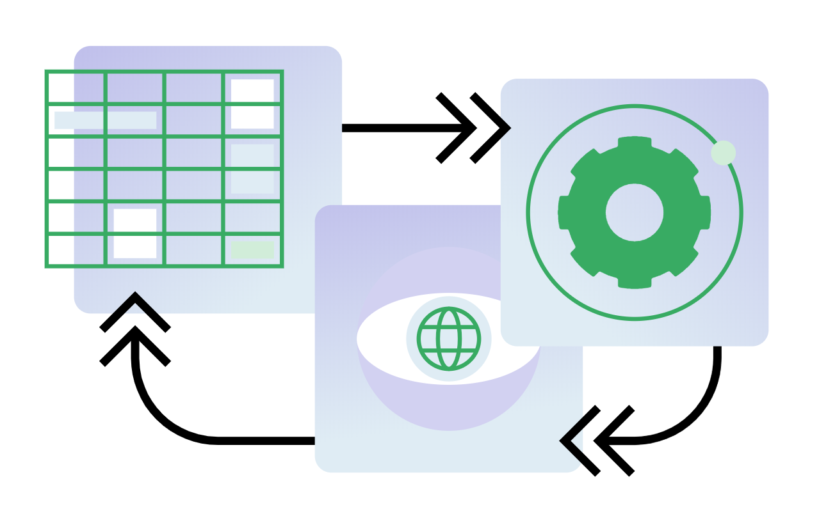
Dynamic modules API. Custom solutions.
Access data stored in Dynamic modules via the Sitefinity API.

Slide 116
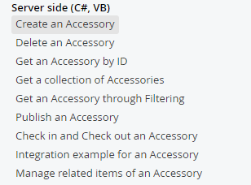
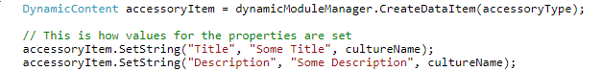
Dynamic modules API. Custom solutions.
API can be used to take advantage of module’s data in custom Sitefinity widgets (studied in Sitefinity Advanced Course), custom code implementations, etc.
Very useful code samples are generated in the Sitefinity project upon creating a dynamic module.

Slide 117
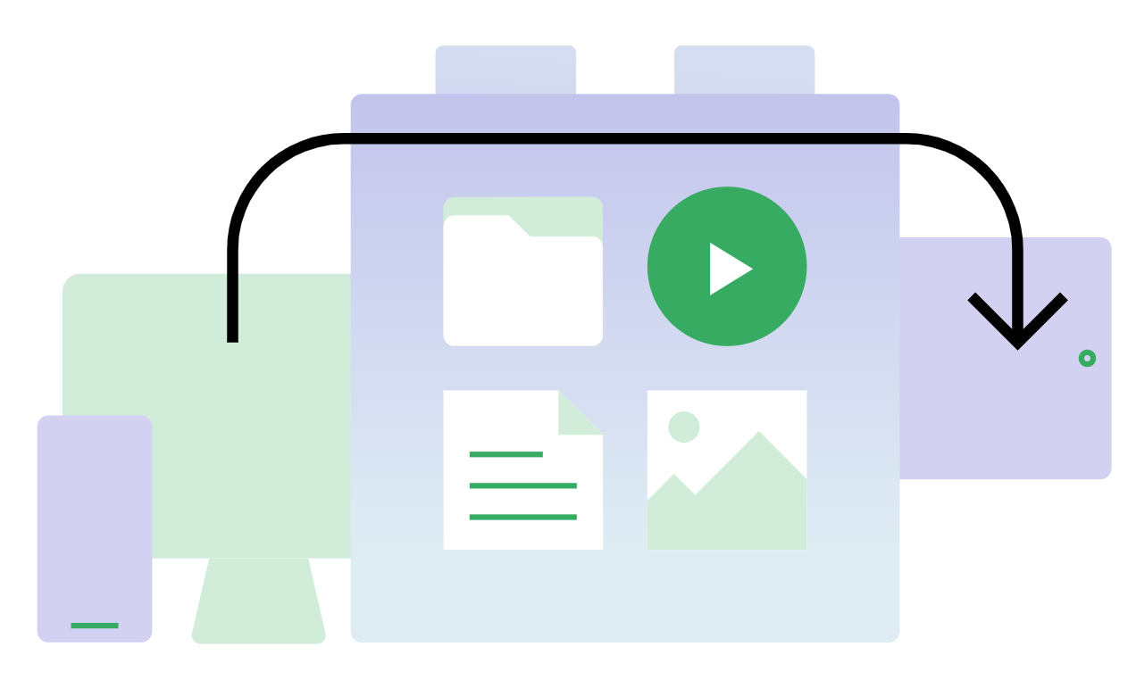
Sitefinity Events. EventHub.
Powerful event system that lets you plug and execute custom logic on various stages of various events.

Slide 118
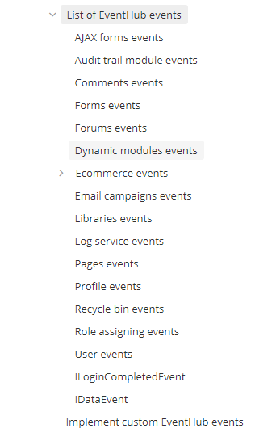
List of EventHub events
IDataEvent – all content;
Pages Events;
Forms events;
Dynamic modules events;
User Events;
and many more…
Events are well described in the EventHub Sitefinity documentation, incl. code snippets and examples.

Slide 119
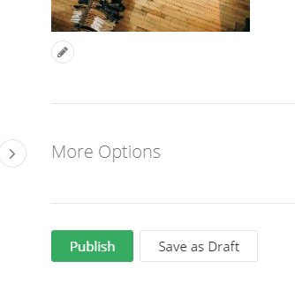
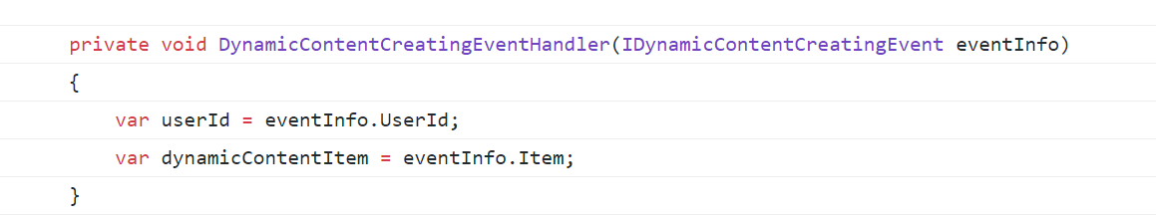
EventHub subscribe and unsubscribe.
Example: Subscribe to Dynamic Content creation, so we can execute our custom logic when new Dynamic content item is created.
Notes:
You have animation here. Single click is sufficient. Click when you say “When you Publish an item….” Animation “your custom logic is executed”

Slide 120
Lesson 9 Working with Configurations

Slide 121
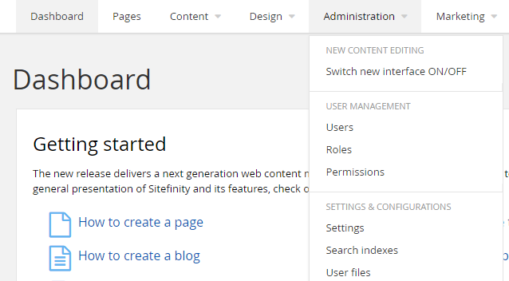
Sitefinity Configurations
Modify settings entirely through the Sitefinity CMS backend UI

Slide 122
Sitefinity Configurations
Web.config
The web.config file includes only standard ASP.NET configurations.
~/App_Data/Sitefinity/Configurations
Sitefinity-specific settings are put into separate configuration files in the App_Data/Sitefinity/Configurations folder.
Database
Sitefinity-specific settings might be stored in the database, depending on the user preferred setup.

Slide 123
Live Demo
Configurations UI. Backend walkthrough.

Slide 124
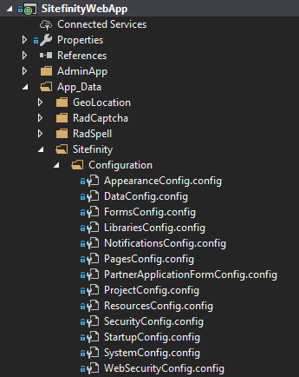
Sitefinity Configurations in Visual Studio
Configurations
AppData > Sitefinity > Configurations
Data.Config file – contains the DB connection string
Before making local database changes, always check the DataConfig.config to make sure you are on the correct Database!
Configuration files should be included and kept in Source Control

Slide 125
Live Demo
Configurations in Visual Studio.

Slide 126
Bonus: How to perform System Restart
Full Restart
Activate/Deactivate Multisite module
Settings » User Authentication » Save changes
Soft Restart
Activate, deactivate, install, or uninstall a module (different than the Multisite module.)
Administration » Version & Licensing and update the license or activate a new one.
Administration » Settings » Languages and add or remove a language.
Administration » Settings » Responsive design and add, activate, deactivate, or update settings.

Slide 127
Lesson 10 Administration

Slide 128

Sitefinity Users
Sitefinity CMS users are users who can conduct content management and/or administrative tasks within a given website project.
Only a user who is granted the Manage Users permission can manage users.
CRUD operations with users – similar to any other module

Slide 129
Sitefinity Roles
A role is a group of users associated with a set of user privileges.
Sitefinity has built-in roles created by default, which have certain permissions assigned to them. (Administrators, Editors, etc.)
Custom Roles with different permissions can be created
You can delete the built-in roles, if you aren’t going to use them. However, you cannot delete the Administrator role.

Slide 130
Live Demo
Users & Roles walkthrough.

Slide 131
Sitefinity Permissions
Permissions are special rules associated with items.
They determine whether a user can execute an action with an item.
Each action can be granted (allowed) or denied to a specific user or role.
You can delete the built-in roles, if you aren’t going to use them. However, you cannot delete the Administrator role.

Slide 132

Individual (granular) Permissions
Sitefinity allows to change the permissions for a simgle item or page
For example, open the News page
Click the Actions link of the article, whose permission you want to change
Click Set Permissions > Break Inheritance

Slide 133
Live Demo
Permissions walkthrough

Slide 134
Q & A

Slide 135
THANK YOU!

